Slide 1
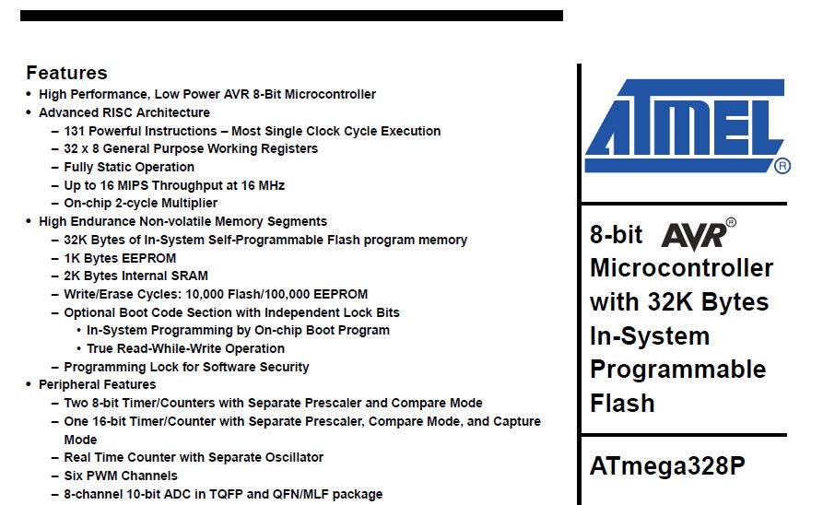
I/O Voltage Question why am I reading less then 5 volts on the output I/O pin
? ? ? ? ? ? ? ? ? ? ? ? ? ? ? ? ? ? ? ? ? ? ? ? ? ? ? ? ? ? ? ? ? ? ?
Atmega 328P Data sheet

Slide 2
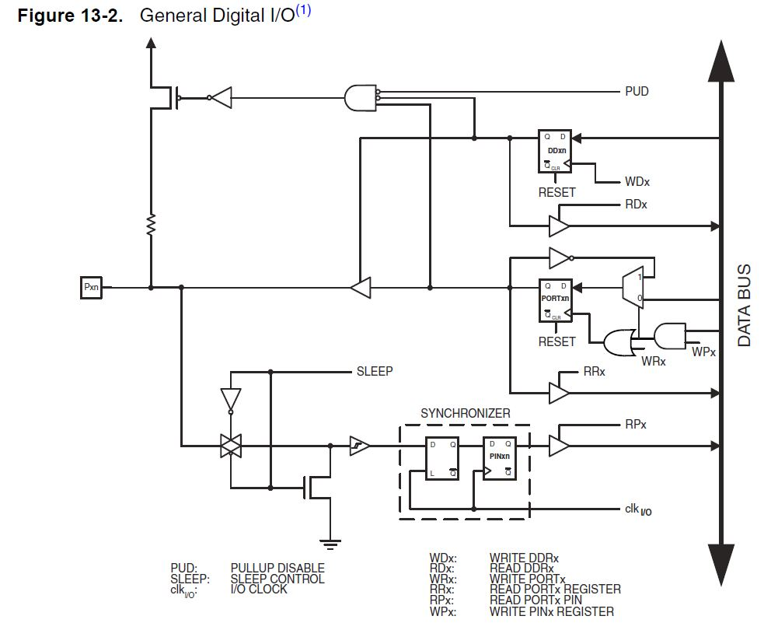
Atmel I/O circuit schematic
+ 5 volts
FET switch
Voltage source resistor
I/O pin
pulled up mode

Slide 3
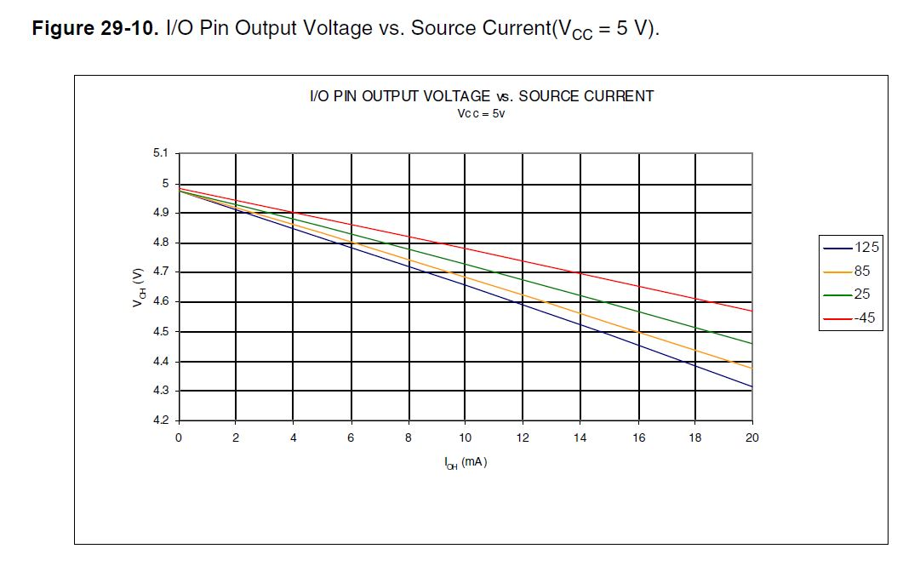

Slide 4
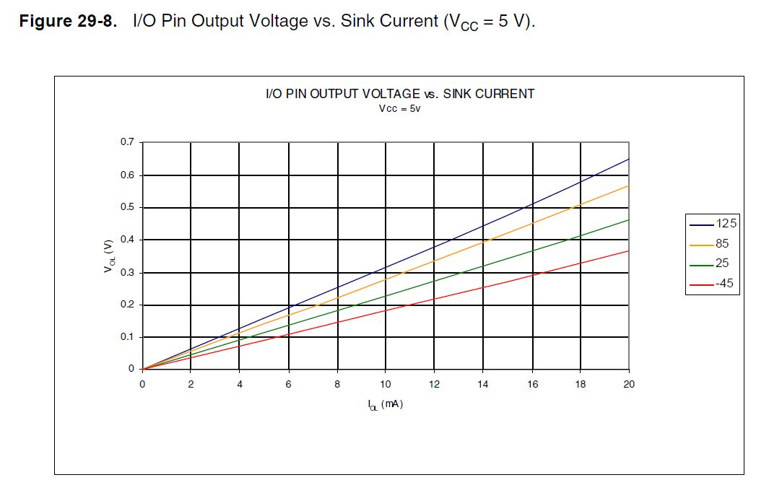

Slide 5
Programming “Arduino”
LCD Displays
Interfaces & Sketches
Instructor / Facilitator - Alan Rux

Slide 6
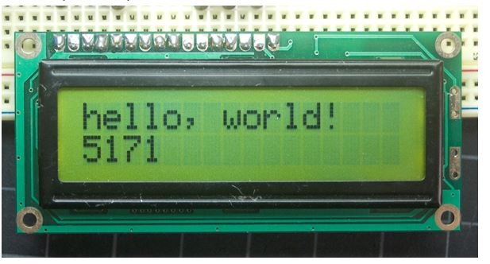
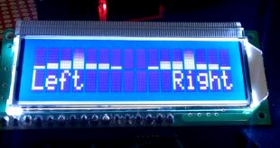
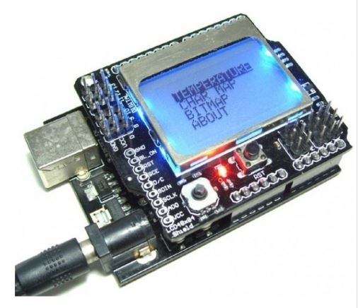
Liquid Crystal Displays

Slide 7
Liquid Crystal Displays
a optical twisted light nematic device
All the LCD displays controller IC’s use the architecture introduced by Hitachi
Most of the LCD Displays available in the market are 16X2 (That means, the LCD displays are capable of displaying 2 lines each having 16 Characters a line)

Slide 8
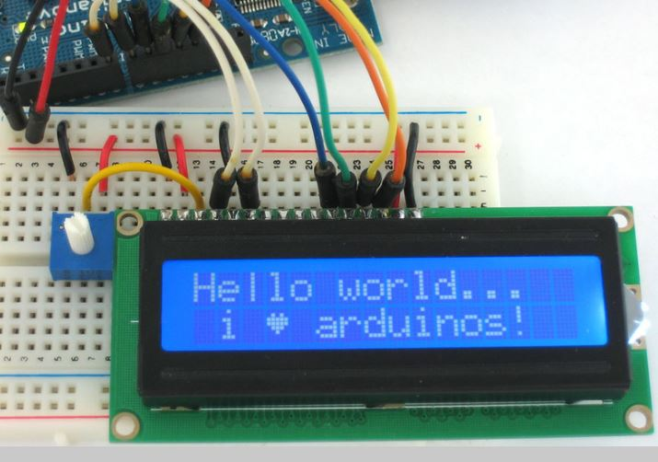
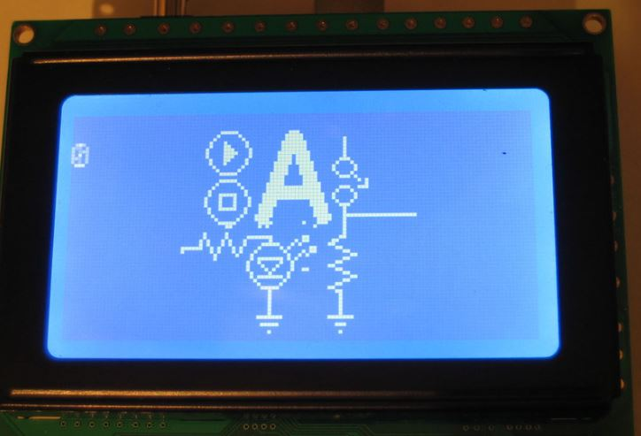
Character vs. Graphical LCDs
5 X 7 pixel rectangles
rolls & columns
Display text
Pixel size from 100 X 100
to
1000 X 750 pixels
Display graphical
images

Slide 9
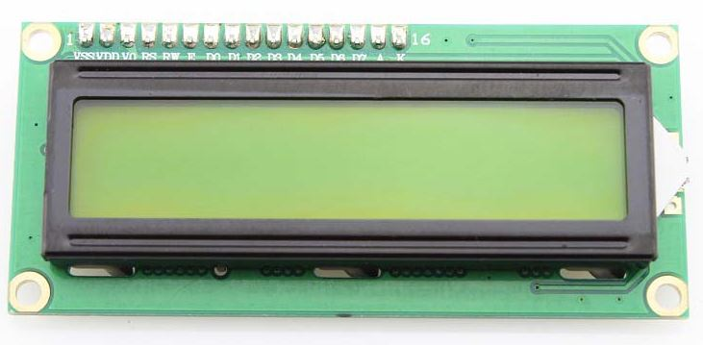
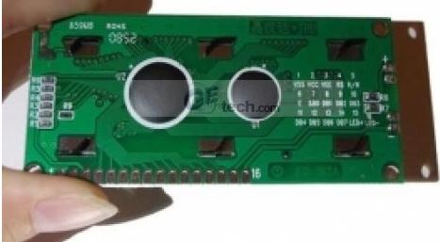
2X16 Display Front and Back View

Slide 10
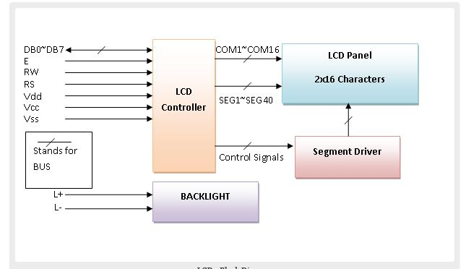
LCD Block Diagram

Slide 11
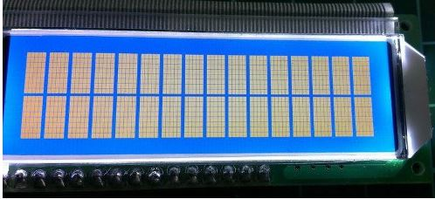
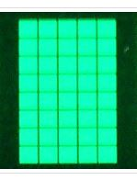
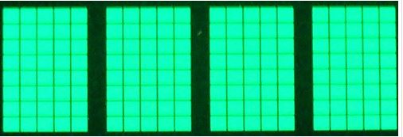
Liquid Crystal Displays Characters
5 by 7 or 5 by 8 pixels

Slide 12
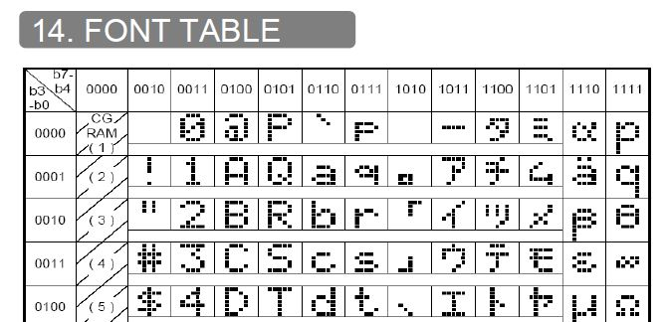
Liquid Crystal Displays Pixels
Bit 7 is MSB

Slide 13
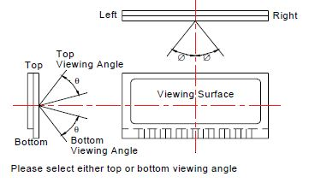
Viewing Angle of LCDs
Typical +/- 30 degrees, General Liquid Crystal Displays have a limited viewing angle. They lose contrast and become hard to read at some viewing angles

Slide 14

Displays come in colors and with or without back-lighting

Slide 15
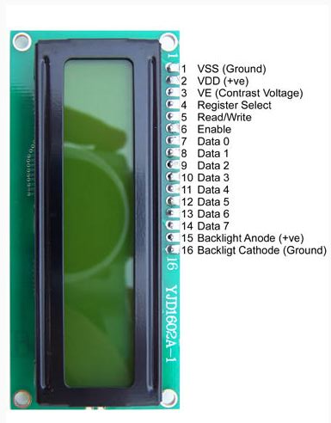
LCD Pin Configuration 16 X 2 display

Slide 16
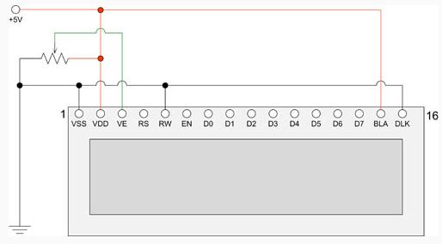
LCD back-light schematic 16 X 2 display
10 K pot.

Slide 17
Connecting to Arduino
The Hitachi-compatible LCDs can be controlled in two modes: 4-bit or 8-bit. The 4-bit mode requires seven I/O pins from the Arduino, while the 8-bit mode requires 11 pins. For displaying text on the screen, you can do most everything in 4-bit mode.
To wire your LCD screen to your Arduino, connect the following pins:
LCD RS pin to digital pin 12
LCD Enable pin to digital pin 11
LCD D4 pin to digital pin 5
LCD D5 pin to digital pin 4
LCD D6 pin to digital pin 3
LCD D7 pin to digital pin 2
Additionally, wire a 10K pot to +5V and GND, with it's wiper (output) to LCD screens VO pin (pin3).

Slide 18
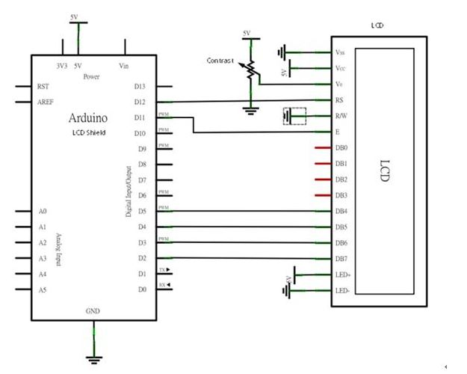
Connecting to Arduino

Slide 19
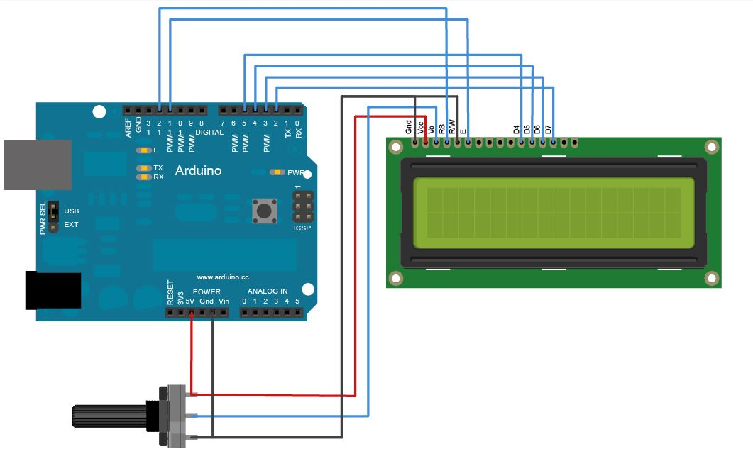
Connecting to Arduino
Wire pin 15 to +5 v with 220 ohms resistor in series,
pin 16 to gnd.
4 Bit Data Mode
Contrast adjust control 10K ohms pot

Slide 20
LCD Sketch “Hello, SVECW” +second count p.1
* LCD RS pin to digital pin 12
* LCD Enable pin to digital pin 11
* LCD D4 pin to digital pin 5
* LCD D5 pin to digital pin 4
* LCD D6 pin to digital pin 3
* LCD D7 pin to digital pin 2
* LCD R/W pin to ground
* 10K resistor:
* ends to +5V and ground
* wiper to LCD VO pin (pin 3)
*/

Slide 21
LCD Sketch “Hello, SVECW” +second count p.2
// include the library code:
#include <LiquidCrystal.h>
// initialize the library with the numbers of the interface pins
LiquidCrystal lcd(12, 11, 5, 4, 3, 2);
void setup() {
// set up the LCD's number of columns and rows:
lcd.begin(16, 2);
// Print a message to the LCD.
lcd.print(“Hello, SVECW");
}
void loop() {
// set the cursor to column 0, line 1
// (note: line 1 is the second row, since counting begins with 0):
lcd.setCursor(0, 1);
// print the number of seconds since reset:
lcd.print(millis()/1000);
}

Slide 22
References LiquidCrystal
#include <LiquidCrystal.h> #include is used to include outside libraries in your sketch. <LiquidCrystal.h> is the library based on the Hitachi HD44780
LiquidCrystal lcd(12, 11, 5, 4, 3, 2);
LiquidCrystal(rs, enable, d4, d5, d6, d7)
rs: the number of the Arduino pin that is connected to the RS pin on the LCD
enable: the number of the Arduino pin that is connected to the enable pin on the LCD
d0, d1, d2, d3, d4, d5, d6, d7: the numbers of the Arduino pins that are connected to the corresponding data pins on the LCD.
d0, d1, d2, and d3 are optional;
if omitted, the LCD will be controlled using only the four data lines
d4, d5, d6, d7

Slide 23
References LiquidCrystal p2
begin() Initializes the interface to the LCD screen, and specifies the dimensions (width and height) of the display. begin() needs to be called before any other LCD library commands
lcd.begin(cols, rows);
lcd: a variable of type LiquidCrystal
cols: the number of columns that the display has
rows: the number of rows that the display has
lcd.begin(16, 2);
# of columns , # of rows

Slide 24
References LiquidCrystal
setCursor() setCursor() method to reposition the cursor. To move the cursor, just call setCursor() with a row and column position.
lcd.setCursor(0, 1);
column #, row #
( 0,0)
2x16 display (column#, row#)
( 15,0)
( 0,1)
( 15,1)

Slide 25
References LiquidCrystal p3
lcd.print(millis()/1000);
millis() Returns the number of milliseconds since the Arduino board began running the current program.
/1000 divides the number of milliseconds by 1000 to get seconds

Slide 26
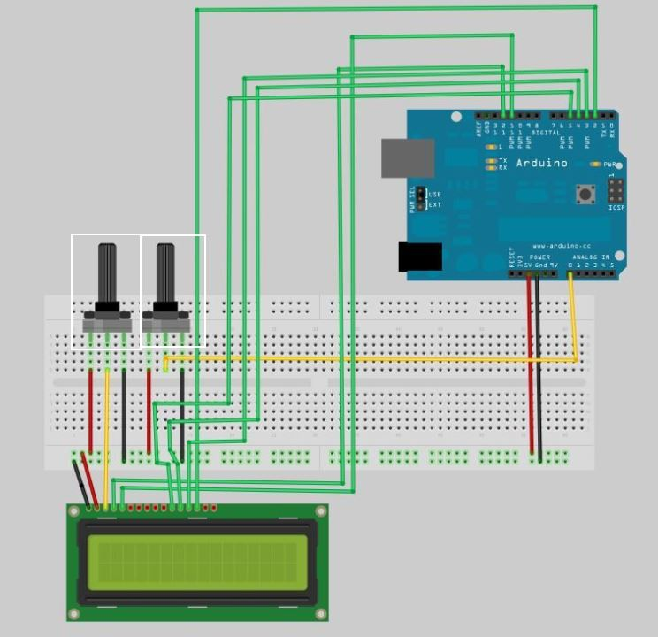
Arduino Digital Voltmeter
A 10k pot was added to solderless breadboard, pot ends connected to +5v & gnd., pot. center arm to analog input pin A0

Slide 27
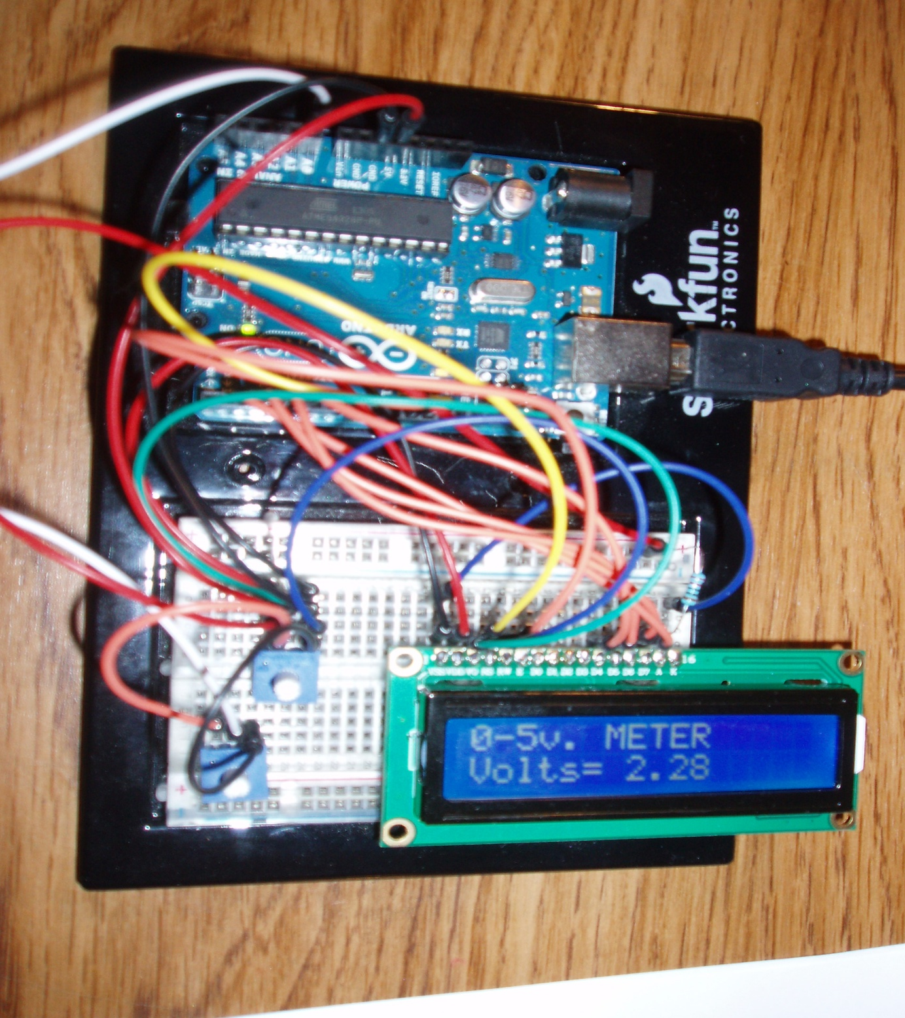
Digital
Voltmeter
0 to 5v. Trimpot with wiper arm to LCD contrast adjust pin VE
0 to 5v. Trimpot with wiper arm to analog input pin A0

Slide 28

Digital Voltmeter Connections to
Arduino & LCD
0 to 5volts
Input to A/D pin A0
220 ohms
Resistor for IC pin
protection

Slide 29
Arduino Digital Voltmeter Sketch p1
/*
LCD RS pin to digital pin 12
LCD Enable pin to digital pin 11
LCD D4 pin to digital pin 5
LCD D5 pin to digital pin 4
LCD D6 pin to digital pin 3
LCD D7 pin to digital pin 2
LCD R/W pin to ground
pot wiper to LCD VO pin (pin 3)
Potentiometer attached to analog input 0
center pin of the pot. to the analog pin A0
*/
#include <LiquidCrystal.h> //include the library code.
int val = 0;
LiquidCrystal lcd(12, 11, 5, 4, 3, 2); // LCD pins connected to the arduino pins

Slide 30
Arduino analog input display Sketch p2
void setup() {
// set up the LCD's number of columns and rows.
lcd.begin(16, 2); //initializes interface to LCD screen
pinMode(A0, INPUT);
lcd.setCursor(0,0); //sets LCD start point, Col 0, Row 0 for next line of code
lcd.print("0-5v. METER"); // display of 1st line on LCD
lcd.setCursor(0,1); //sets LCD start point, Col 0, Row 1 for next line of code
lcd.print("Volts="); // display 2nd line on LCD
}

Slide 31
Arduino analog input display Sketch p3
void loop() {
lcd.setCursor(7,1); //sets LCD start point, Col 7, Row 1 for voltage value
lcd.print(analogRead(0)/204.6); //Converts arduino's 0-1023 to 0.00-5.00
delay(300); //delay of 3ooms. for stability
}

Slide 32
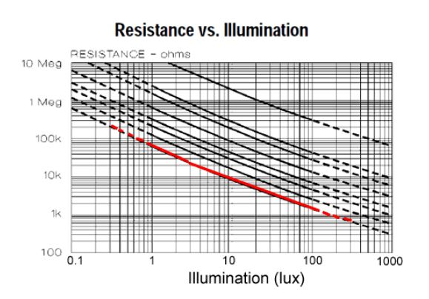
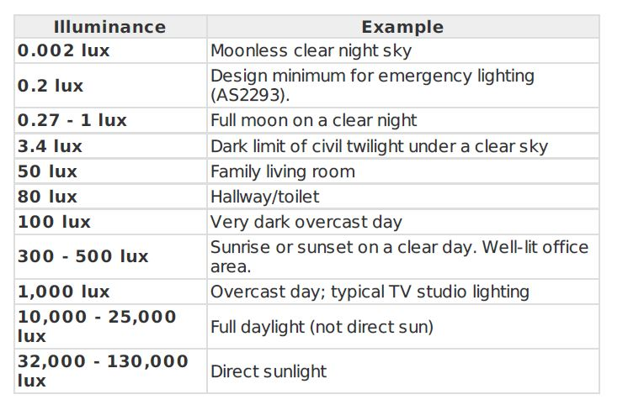
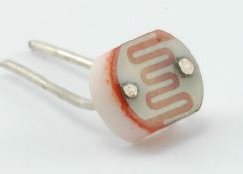
Digital Light meter DYIASDE
Using the light-dependent resistors from the A/D converter input slide sets design me a “Light Meter” and display the reading in “LUX” values.
I used a 10K ohm resistor and had a voltage swing of 4.7v to .45v, bright light to dark. Some <,> math functions might be needed for ruff calibration.
A step function is OK for this Lab., at least 6 steps please.
Enjoy your Lab.
LDR

Slide 33
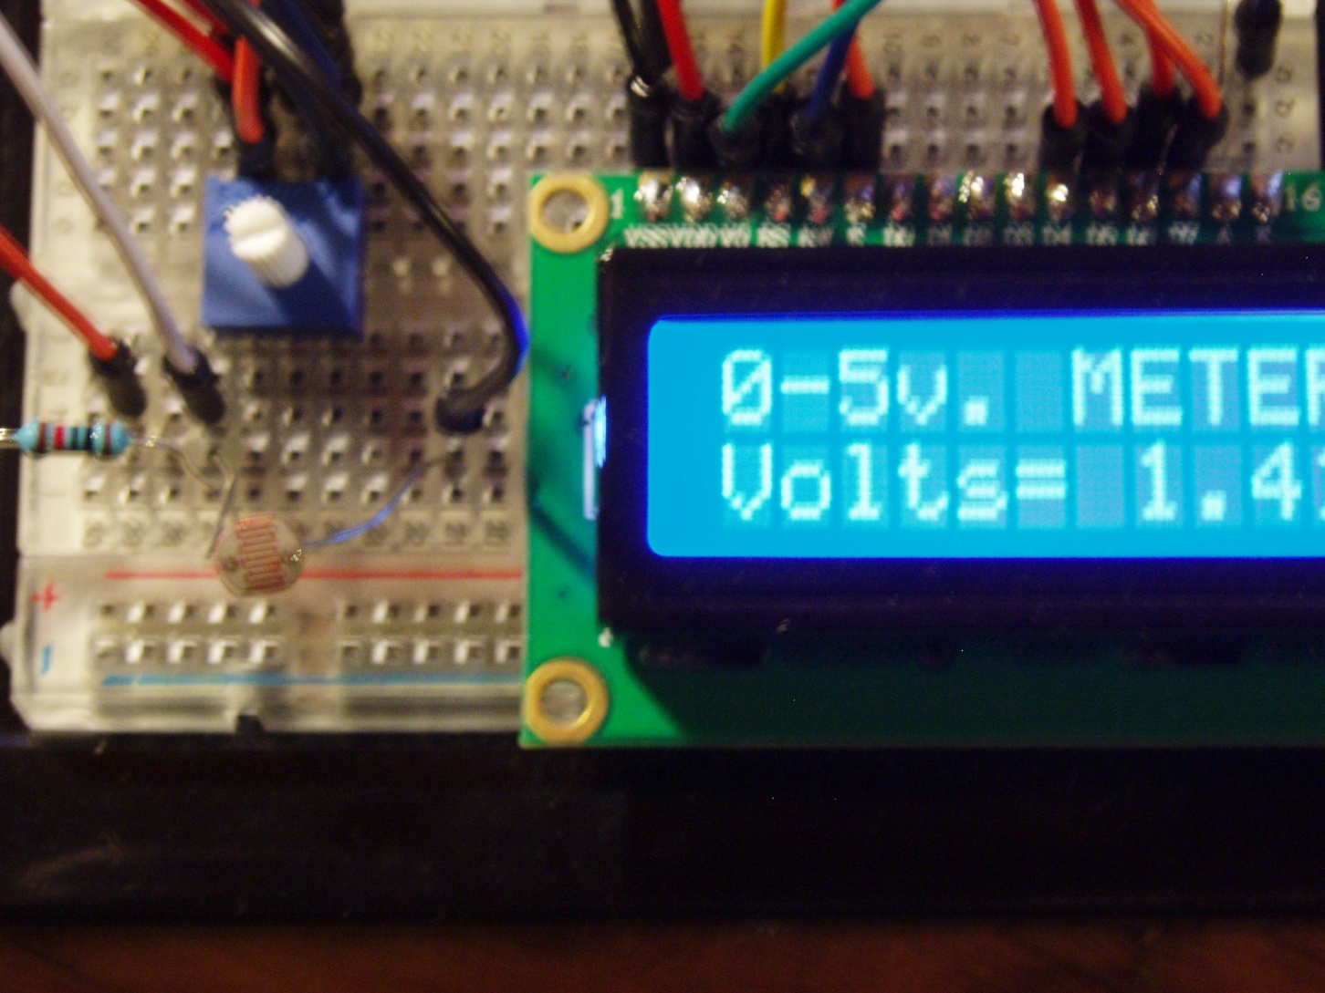
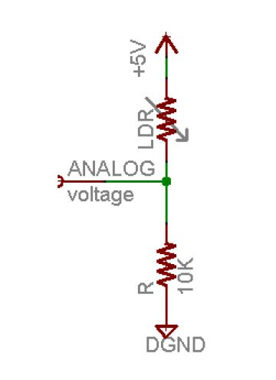
Digital Light meter DYI
10k resistor
Light Dependent Resistor

