Slide 1
Programming “Arduino”
Sketches
Digital Inputs/Outputs
Instructor / Facilitator - Alan Rux

Slide 2
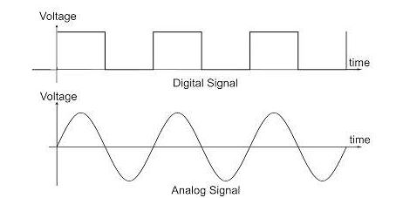
Analog versus Digital signals
The term digital signal refers to two discrete voltage states changing over time. These states represent a higher and lower voltage
High (on=1=+5volts)
or
Low (off=0=0 volts)
Variable voltage,
+/- voltage from voltage reference point
The term analog signal refers to continuously varying voltage over time

Slide 3
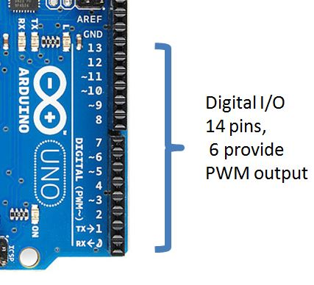
“Platform”
Digital I /O Pins
D0 to D13 = 14 pins
“O” = O v., “1” = +5v.
Six pins = PWM output
D3,D5,D6,D9,D10,D11
I/O pin 0 = RX, I/O pin1=TX
(serial com, port)
I/O current limited
(see next slide)

Slide 4
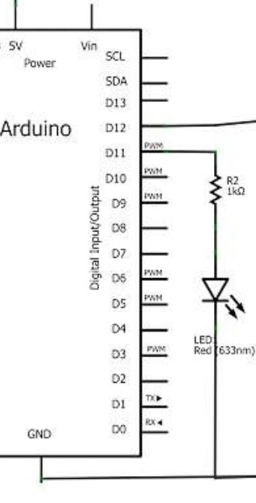
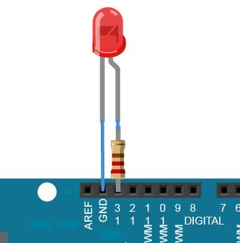
Digital I /O Pins output current limits
40 ma. Max current / pin
200 ma. Max for IC
(all pins total)
< 10ma. Recommended
Use 560 ohm resistor to 1k ohm resistor for current limiter
Output Z very low ohms

Slide 5
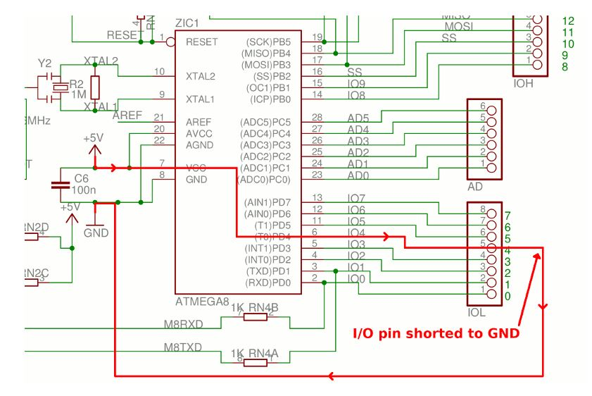
The microcontroller datasheet specifies an absolute maximum per-pin current of 40mA. With a typical internal resistance of only 25 ohms per pin, a dead short to ground can allow as much as 200mA of current to flow, more than enough to destroy the microcontroller pin.

Slide 6
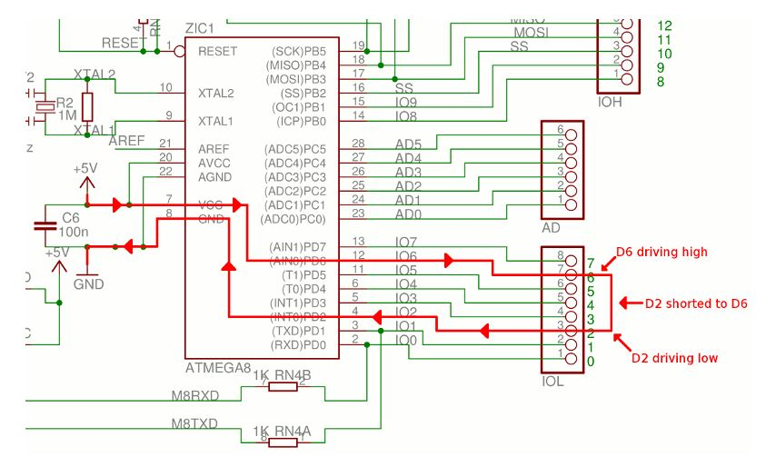
Configure two I/O pins to be outputs then set one high and the other one low. Now connect the pins together. You have now created an overcurrent condition on both I/O pins and they will be destroyed.

Slide 7
Digital I /O Pins Inputs
When a pin is configured as an INPUT with pinMode, and read with digitalRead, the microcontroller will report HIGH if a voltage of 3 volts or more is present at the pin
The microcontroller will report LOW if a voltage of 2 volts or less is present at the pin
Arduino pins configured as INPUT with pinMode() are said to be in a high-impedance state. Pins configured as INPUT make extremely small demands on the circuit that they are sampling, equivalent to a series resistor of 100 Megohms in front of the pin. This makes them useful for reading a sensor, but not powering an LED.
Often it is useful to steer an input pin to a known state if no input is present. This can be done by adding a pullup resistor (to +5V), or a pulldown resistor (resistor to ground) on the input. A 10K resistor is a good value for a pullup or pulldown resistor

Slide 8
Digital I /O Pins Outputs
Pins configured as OUTPUT with pinMode() are said to be in a low-impedance state. This means that they can provide a substantial amount of current to other circuits. Atmega pins can source (provide positive current) or sink (provide negative current) up to 40 mA (milliamps) of current to other devices/circuits. This is enough current to brightly light up an LED (don't forget the series resistor), or run many sensors, for example, but not enough current to run most relays, solenoids, or motors
Short circuits on Arduino pins, or attempting to run high current devices from them, can damage or destroy the output transistors in the pin, or damage the entire Atmega chip. Often this will result in a "dead" pin in the microcontroller but the remaining chip will still function adequately.
For this reason it is a good idea to connect OUTPUT pins to other devices with 470Ω to 1k series resistor.

Slide 9
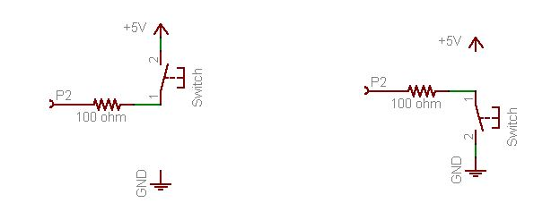
Digital Inputs - Pull Up / Down
Simple circuit Push Button
Note 470 ohm resistor, this prevents you from burning out the I/O pin, if by mistake, it is programmed as an output and connected to +5 volts or ground, 0 volts. The 470Ω resistor acts as a buffer, to protect the pin from short circuits
When circuit is in open position the input I/O pin can float and give unreliable readings, High or Low (see next slide)

Slide 10
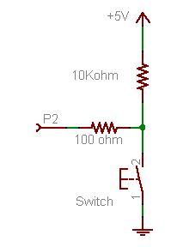
Digital Inputs - Pull-Up Circuit
By adding a 10 K ohm resistor the input pin is in the high input signal position until the Push Button is pressed and shorts the input to ground, a digital low signal
This is called an “active low” input
10. K ohms
470 ohms

Slide 11
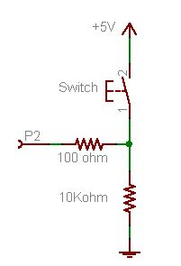
Digital Inputs - Pull-Down Circuit
By adding a 10 K ohm resistor the input pin is in the low input signal position until the Push Button is pressed and connects the input to + 5 volts, a digital high signal
This is called an “active high” input
470 ohms

Slide 12
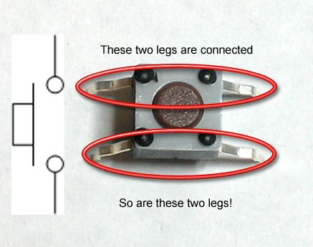
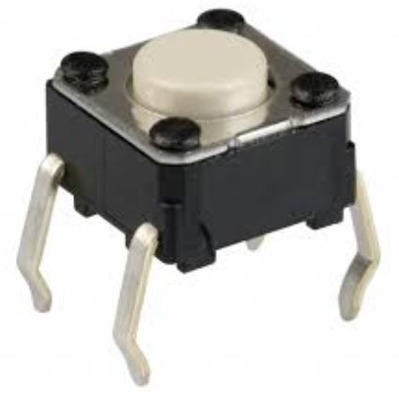
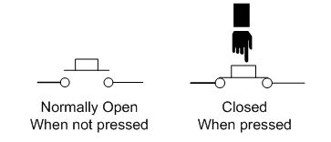
Pushbutton Switches
Pushbutton switches are two-position devices actuated with a button that is pressed and released. Most pushbutton switches have an internal spring mechanism returning the button to its "out," or "unpressed," position, for momentary operation.
Normally Open PushButton switch

Slide 13
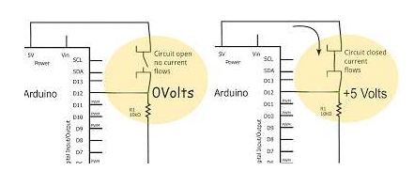
Pushbutton Switch
Digital I/O Input Circuit
Active when High digital input
Gnd, 0 volts
Gnd, 0 volts

Slide 14
Push Button test program (1 of 2 pages)
( red is comments statement )
// Pushbutton program reports when a button is pushed and released
// Constant integer used to set pin numbers >
const int buttonPin = 12; // the number of the pushbutton pin
// variables
//(Variables may change while the program runs)
int buttonState = 0; // variable the pushbutton status
void setup() {
// initialize Serial communications
Serial.begin(9600);
// set the buttonPin mode to INPUT
pinMode(buttonPin, INPUT);
}

Slide 15
Push Button test program (2of 2 pages)
( red is comments statement )
void loop(){
// get the state of the pushbutton
buttonState = digitalRead(buttonPin);
// is the button pressed?
// if it is, the buttonState is HIGH:
if (buttonState == HIGH) {
// Tell the world
Serial.println("Button pushed.");
}
else {
Serial.println("Button not pushed.");
}
delay(500); // pause for 1/2 a second
}

Slide 16
if (buttonState == HIGH)
if, which is used in conjunction with a comparison operator, tests whether a certain condition has been reached, such as an input being above a certain number. The format for an if test is:
if (someVariable ==HIGH) { // do something here }
== , use the double equal sign
(e.g. if (buttonState == HIGH) ), which is the comparison operator, and tests whether xbuttonState is equal to digital HIGH or not.

Slide 17
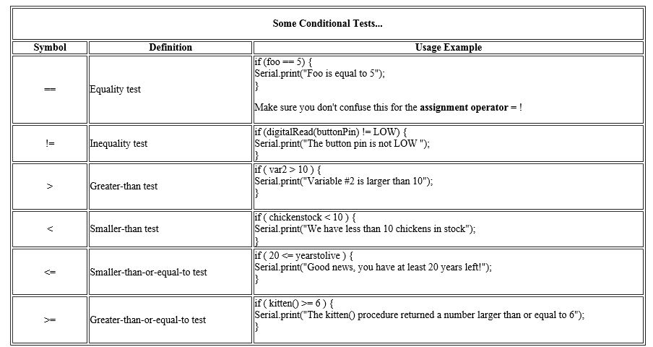
some comparison operators

Slide 18
Serial.println("Button pushed.");
You can use the Arduino environment's built-in serial monitor to communicate with an Arduino board. Click the serial monitor button in the toolbar and select the same baud rate used in the call to begin().
println(val) Prints data to the serial port as human-readable ASCII text followed by a carriage return character
println(val) val: the value to print - any data type . ("Button pushed.")

Slide 19
else {
Serial.println("Button not pushed.");
Else if/else allows greater control over the flow of code than the basic if statement, by allowing multiple tests to be grouped together
In the case that the input is not HIGH the else comparison statement prints “Button not pushed” on the serial IDE monitor.
We have a 500 ms delay and loop back to if again, repeat over and over.

Slide 20
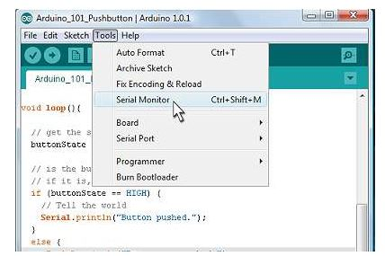
Push Button test program
We will use the serial monitor on the Arduino IDE

Slide 21
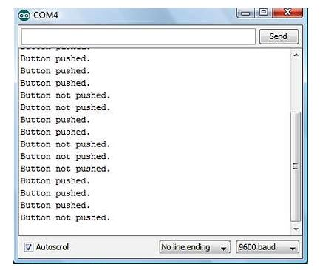
Push Button test program
We will use the serial monitor on the Arduino IDE to show status of input pin

Slide 22
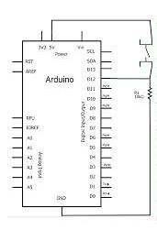
Push Button Schematic
I/O pin 12 is used as a digital input
Add 220 ohm resistor between pin 12 and 10k ohm pull down resistor and push button switch
Read switch status as pressing switch,

Slide 23

Another Push Button test program
( red is comments statement )
/*
* Switch test program
*/
int switchPin =12; // Switch connected to digital pin 12
void setup() // run once, when the sketch starts
{
Serial.begin(9600); // set up Serial library at 9600 bps
pinMode(switchPin, INPUT); // sets the digital pin as input to read switch
}
void loop() // run over and over again
{
Serial.print ("Read switch input: ");
Serial.println(digitalRead(switchPin)); // Read the pin and display the value
delay(100);
}

Slide 24
combine inputs (buttons) and outputs (LEDs)
Sketch
Verify that when the button is pressed, the LED turns on and when the button is released, the LED turns off. ( 1 of 2 pages)
/*
* Switch and LED test program
*/
int ledPin = 11; // LED is connected to pin 11
int switchPin = 12; // switch is connected to pin 12
int val; // variable for reading the pin status
void setup() {
pinMode(ledPin, OUTPUT); // Set the LED pin as output
pinMode(switchPin, INPUT); // Set the switch pin as input
}

Slide 25
combine inputs (buttons) and outputs (LEDs)
Sketch
Verify that when the button is pressed, the LED turns on and when the button is released, the LED turns off. (2 of 2 pages)
void loop(){
val = digitalRead(switchPin); // read input value and store it in val
if (val == LOW) { // check if the button is pressed
digitalWrite(ledPin, HIGH); // turn LED on
}
if (val == HIGH) { // check if the button is not pressed
digitalWrite(ledPin, LOW); // turn LED off
}
}

Slide 26
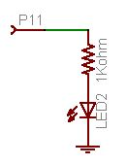
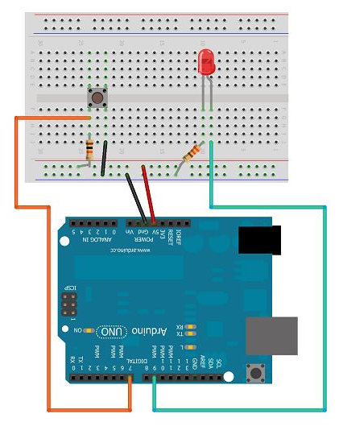
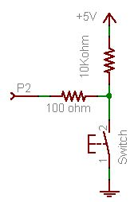
Schematic
LED is connected to pin 11
switch is connected to pin 12

Slide 27
Switch Contact Bounce
You spend some time looking over your code but can't seem to find the problem.
Turns out this is not a software (sketch) problem, but actually a mechanical problem.
Inside the little tactile switch is a small disc spring. When you push the button you squeeze the spring so that it makes contact with the two wire connections. When you release, the spring bounces back. This works great except that, the spring is springy. And that means that once in a while, when you press the button it bounces around a little in the switch, making and breaking contact a few times before settling
This “bounce” can be interpreted as many switch presses,
causing the microcontroller to think the switch has been presses a few times and operates as if that is true causing miss interpretation and unwanted results

Slide 28
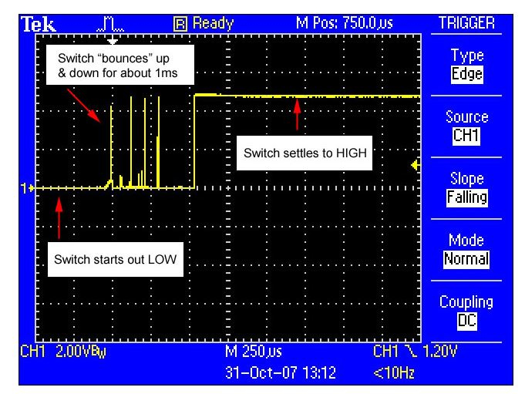
Switch Contact Bounce scope trace

Slide 29
Switch Debounce
This example demonstrates how to debounce an input, which means checking twice in a short period of time to make sure it's definitely pressed. Without debouncing, pressing the button once can appear to the code as multiple on/off inputs.
Using the same schematic as in the “combine inputs (buttons) and outputs (LEDs) Sketch” we will do a LED toggle on or off with switch pushbutton pressing.
First without de-bounce then with de-bounce.

Slide 30
Schematic
LED is connected to pin 11
Try the Toggle without the debounce first,
Then add the delay(500) function to debounce the switch.
switch is connected to pin 12

Slide 31
LED Toggle Sketch (no debounce)
// Led toggle
int inputPin = 12; // push button switch pin 12
int ledPin = 11; // Led wired to pin 11
int ledValue = LOW
void setup ()
{
pinMode (inputPin, INPUT); // set pin 12 to input
pinMode (ledPin, OUTPUT); // set pin 11 to output
}
void loop ()
{
if (digitalRead (inputPin) == LOW)
{
ledValue = ! ledValue;
digitalWrite (ledPin, ledValue);
} }

Slide 32
LED Toggle Sketch (with debounce)
// Led toggle
int inputPin = 12; // push button switch pin 12
int ledPin = 11; // Led wired to pin 11
int ledValue = LOW;
void setup()
{
pinMode(inputPin, INPUT); // set pin 12 to input
pinMode(ledPin, OUTPUT); // set pin 11 to output
}
void loop ()
{
if (digitalRead (inputPin) == LOW)
{
ledValue = ! ledValue;
digitalWrite (ledPin, ledValue);
delay (500); // 500 ms delay to get past switch bounce
} }

Slide 33
Questions
What does the IDE Serial Monitor do?
How do you mark comments in your sketch
Why do you have to debounce a switch ?
Can you see the bounce using your Analog Discovery Kit scope? Free-run or single sweep mode?
Can you see the effect of the bounce on the Led ?
Did you play around with the delay time to see the minim time required to debounce?

